Slide 1
ERASMUS+CRIMSON “DEBATING”
SUBJECT: ENGLISH LANGUAGE
Teacher: Ipermahia Christodoulou
LESSON PLAN

Slide 2
Grade: 5th
Number of students: 16
Time: 45 min
Lesson: “ The place we live!”
Source of material Students’ coursebook

Slide 3
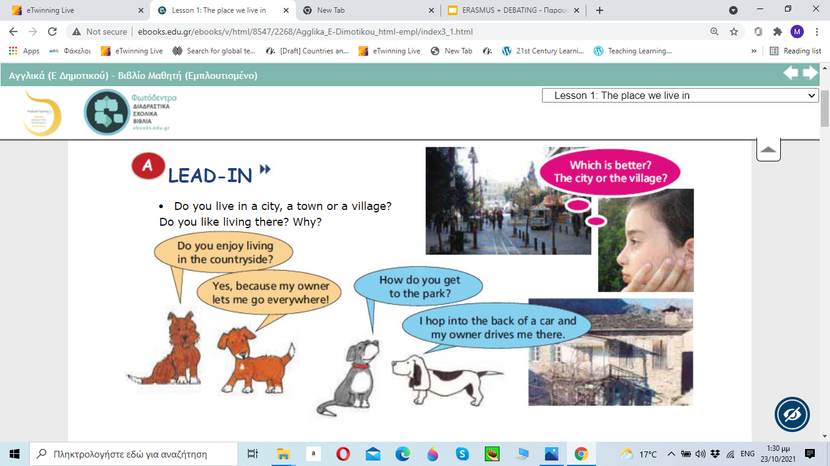
LEAD-IN
10 minutes-Speaking
Do you live in a city, a town or a village?
Do you like living there? Why?

Slide 4
LANGUAGE
Functions:
Expressing opinions and making suggestions
Skills:
Debate: In this House we believe that living in the city is better than living in a village
25 min

Slide 5
Listening/Writing:Listen to the three children talking about the place they live and write a short paragraph about their problems 10 min.

Slide 6

Expressing opinions - Making suggestions
I think that...
I don't think that ….
It seems to me that ...
In my opinion, ….
Why don't you ….
How about …..
Let's ….

